Slide 1



DialogFragment

Slide 2
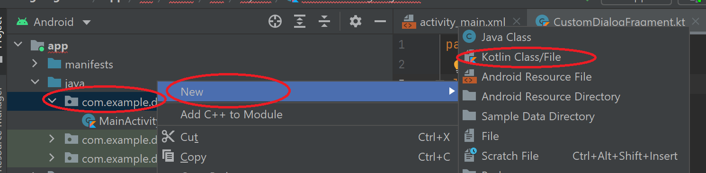
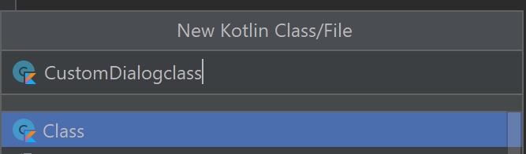
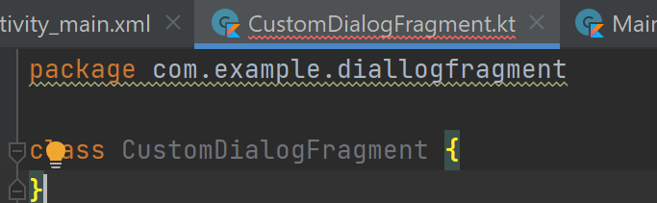
DialogFragment
A DialogFragment is a special fragment subclass that is designed for creating and hosting dialogs.
The FragmentManager manages the state of the dialog and automatically restore the dialog when a configuration change occurs.
Create an empty basic layout project (DialogFragment). Then create a Kotlin class as the following:

Slide 3
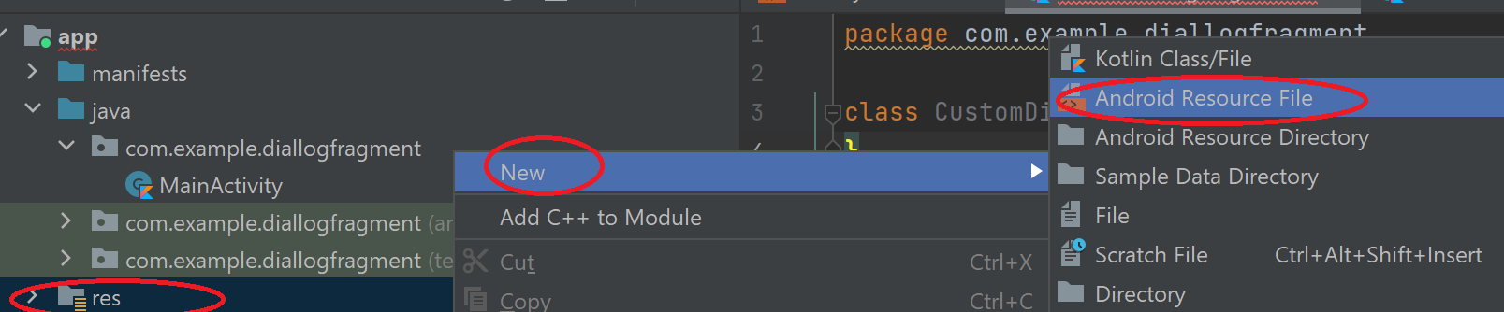
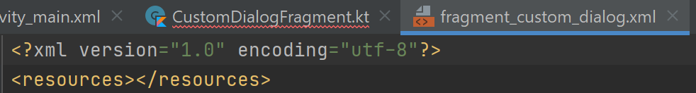
DialogFragment
Create a layout resource file as the following:

Slide 4
Fragment_custom_dialog.xml
<RadioButton android:id="@+id/goodRB" android:layout_width="wrap_content" android:layout_height="wrap_content" android:text="Good“ /> <RadioButton android:id="@+id/satisfactoryRB" android:layout_width="wrap_content" android:layout_height="wrap_content" android:text="Satisfactory“ /> <RadioButton android:id="@+id/poorRB" android:layout_width="wrap_content" android:layout_height="wrap_content" android:text="Poor" /> </RadioGroup> <Button android:id="@+id/cancelBT" android:layout_width="wrap_content" android:layout_height="wrap_content" android:text="Cancel“ /> <Button android:id="@+id/submitBT" android:layout_width="wrap_content" android:layout_height="wrap_content" android:text="Submit"/> </androidx.constraintlayout.widget.ConstraintLayout>
<?xml version="1.0" encoding="utf-8"?> <androidx.constraintlayout.widget.ConstraintLayout android:layout_width="wrap_content" xmlns:android="http://schemas.android.com/apk/res/android" android:layout_height="wrap_content"> <TextView android:layout_width="match_parent" android:layout_height="match_parent" /> <RadioGroup android:id="@+id/RatingRadioGroup" android:layout_width="400dp" android:layout_height="wrap_content" android:padding="25dp"> <RadioButton android:id="@+id/excellentRB" android:layout_width="wrap_content" android:layout_height="wrap_content" android:text="Excellent“ /> <RadioButton android:id="@+id/vgoodRB" android:layout_width="wrap_content" android:layout_height="wrap_content" android:text="Very Good“ />

Slide 5
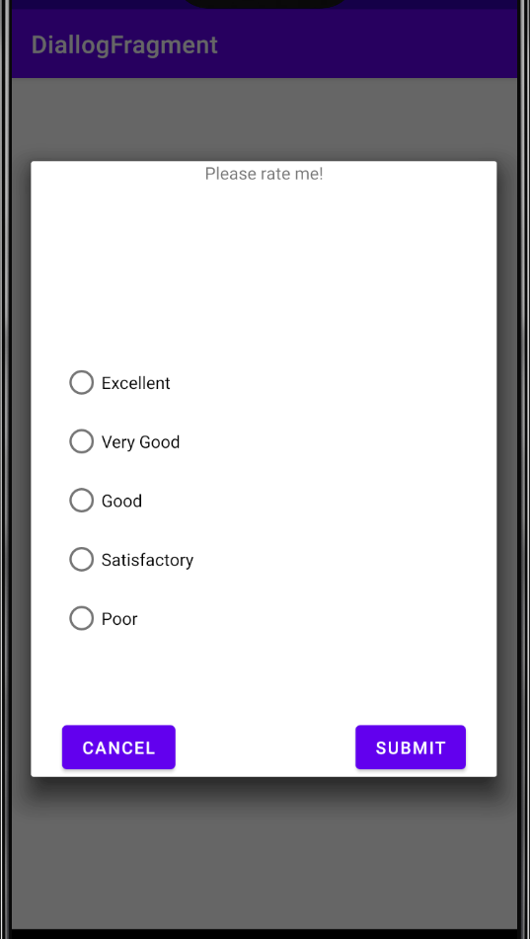
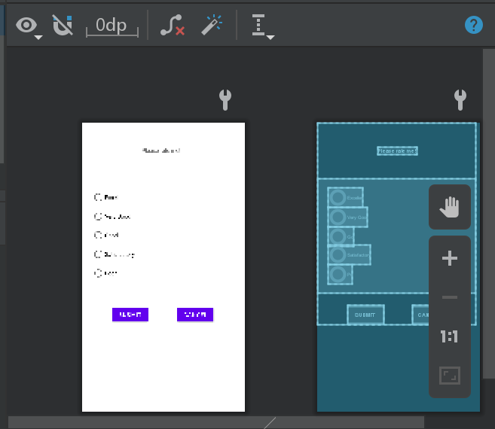
Fragment_custom_dialog.xml
Fix the constraints for all items!

Slide 6
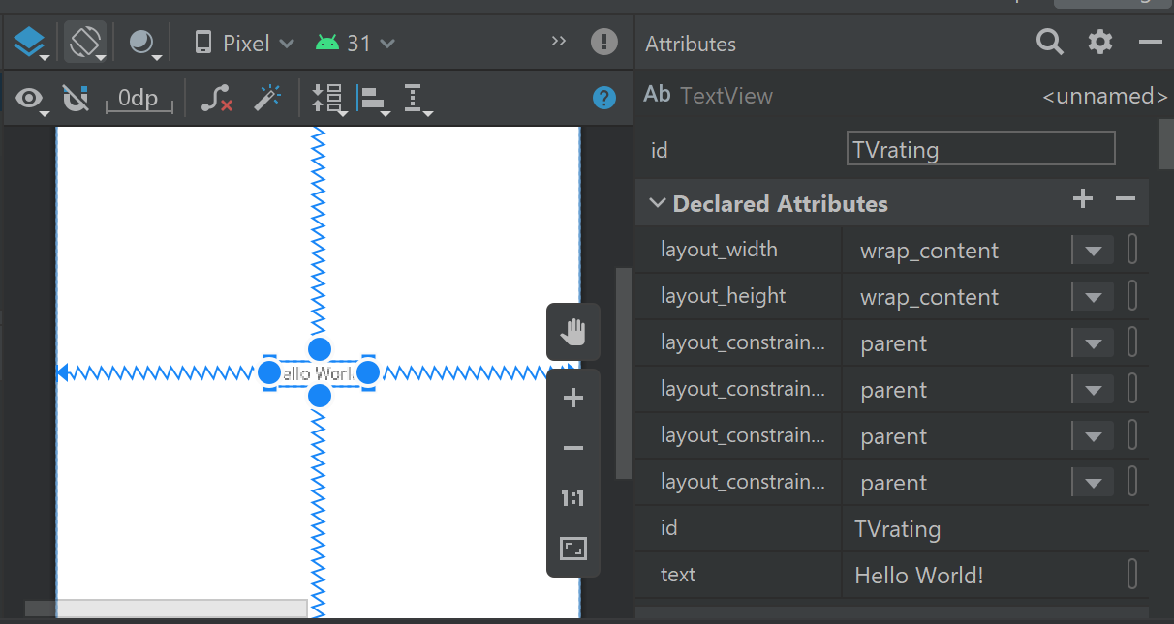
Activity_main.xml
Change the id to be “TVrating” and text to be “Click to rate”.

Slide 7
In MainActivity.kt
class MainActivity : AppCompatActivity() { override fun onCreate(savedInstanceState: Bundle?) { super.onCreate(savedInstanceState) setContentView(R.layout.activity_main) val ratingTV : TextView = findViewById(R.id.TVrating) ratingTV.setOnClickListener{ var dialog_var = CustomDialogFragment() dialog_var.show(supportFragmentManager, "Custom Dialog") } }

Slide 8
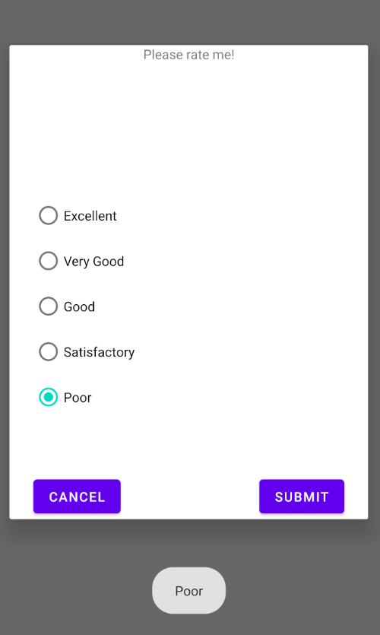
In CustomDialogFragment.kt
import .. class CustomDialogFragment: DialogFragment(R.layout.fragment_custom_dialog) { override fun onViewCreated(view: View, savedInstanceState: Bundle?) { val cancelbt : Button = view.findViewById(R.id.cancelBT); val submitbt : Button = view.findViewById(R.id.submitBT); val radioGroup = view.findViewById<RadioGroup>(R.id.RatingRadioGroup) cancelbt.setOnClickListener{ dismiss() } submitbt.setOnClickListener { val selectedOption: Int = radioGroup.checkedRadioButtonId val radioButton = view.findViewById<RadioButton>(selectedOption) Toast.makeText(context,radioButton.text,Toast.LENGTH_SHORT).show()
dismiss() } } }

Slide 9
modify MainActivity.kt to receive the feedback
class MainActivity : AppCompatActivity() { override fun onCreate(savedInstanceState: Bundle?) { super.onCreate(savedInstanceState) setContentView(R.layout.activity_main) val ratingTV : TextView = findViewById(R.id.TVrating) ratingTV.setOnClickListener{ var dialog_var = CustomDialogFragment() dialog_var.show(supportFragmentManager, "Custom Dialog") } } fun receiveFeedback(feedback: String){ val ratingTV : TextView = findViewById(R.id.TVrating) ratingTV.text = feedback; } }
We create reciveFeedback() function that takes a text ( which will be sent from the fragment) and display it in the TextView.

Slide 10
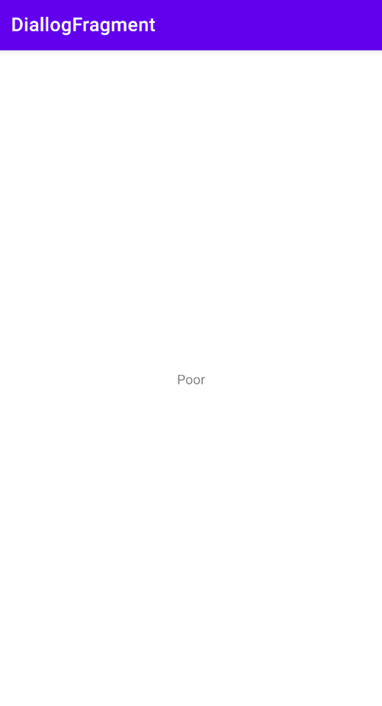
Call feedback in CustomDialogFragment.kt
submitbt.setOnClickListener { val selectedOption: Int = radioGroup.checkedRadioButtonId val radioButton = view.findViewById<RadioButton>(selectedOption) Toast.makeText(context,radioButton.text,Toast.LENGTH_SHORT).show() val m1:MainActivity = getActivity() as MainActivity; m1.receiveFeedback(radioButton.text.toString()) dismiss() }
We have to create companion object to MainActivity in order to call it is functions (In this case, recieveFeedback() ).

Slide 11
References
https://developer.android.com/guide/fragments/dialogs
https://www.youtube.com/watch?v=sGVPCzWqeiw
https://www.youtube.com/watch?v=SkFcDWt9GV4

